Slide 1

KLE SOCIETY’S
CHIDAND.B.KORE POLYTECHNINC, CHIKODI
KARNATAKA 2024-2025
DEPARTMENT OF COMPUTER SICENCE & ENGINEERING
A SYNOPSIS REPORT ON
“HOTEL MANAGEMENT SOFTWARE”
Submitted for partial fulfillment of the requirement of the award of the
DIPLOMA IN COMPUTER SCIENCE & ENGINEERING UNDER THE GUIDENCE OF
Miss . Sarita Khot (Lecturer)
Mr . Rajashekar Bendawade (Lecturer)
A Project Synopsis
By
Akash Talikoti 339CS22007
Siddarth Mali 339CS22051
Yuvaraj Kadam 339CS22059
Abhishek Shintre 339CS23701

Slide 2
Contents
Abstract
Objective
Advantages and Disadvantages
Future Scope
Use Case Diagram
Data flow Diagram
Conclusion
References

Slide 3
Abstract of Project
The Taj Hotel project aims to build a new luxury hotel that combines traditional elegance with modern design. It involves planning the hotel's look, managing its construction with eco-friendly practices, and preparing for a successful launch with top-notch services and a strong marketing strategy.

Slide 4
OBJECTIVE
The objectives of the system are->
Guest Satisfaction.
Operational Efficiency.
Financial Performance.
Staff Management.
Marketing and Sales.
This project is used by two types of users-
1. Customer
2. Builder
Our Building Management Application enables customers to create accounts, view available projects, and apply for specific jobs.
Builders can post job openings, maintain daily updates, and generate reports on project status and worker performance.
Authorized administrators have secure access to user management and system updates, ensuring the application remains current and secure.
The system is designed to be scalable, allowing easy upgrades and the addition of new features to meet evolving requirements.

Slide 5
Advantages & Disadvantages
Advantages->
1. Save time on admin tasks- just you can fill basic information
2. Manage distribution functions- A Huge Project/Task is distributed in many parts to reduce the work.
3. Increases bookings-This will help in business of revenue.
4. Accurate daily reports
Disadvantages->
1.Higher in cost.
2. Overbooking.
3. Cancellation Policies – cash can’t be refund

Slide 6
Future Scope
The future scope of the TAJ Hotel Software, We will provide everything what customer wants and make it easier then other software to Login or other Activity’s like providing Room’s , best Food etc..

Slide 7
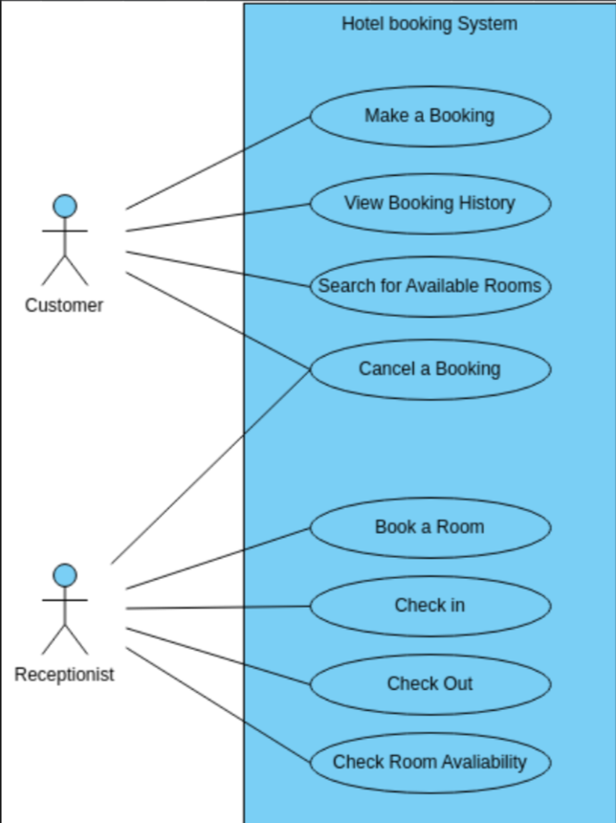
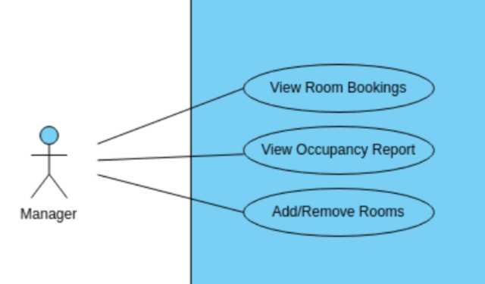
Use Case Diagram

Slide 8
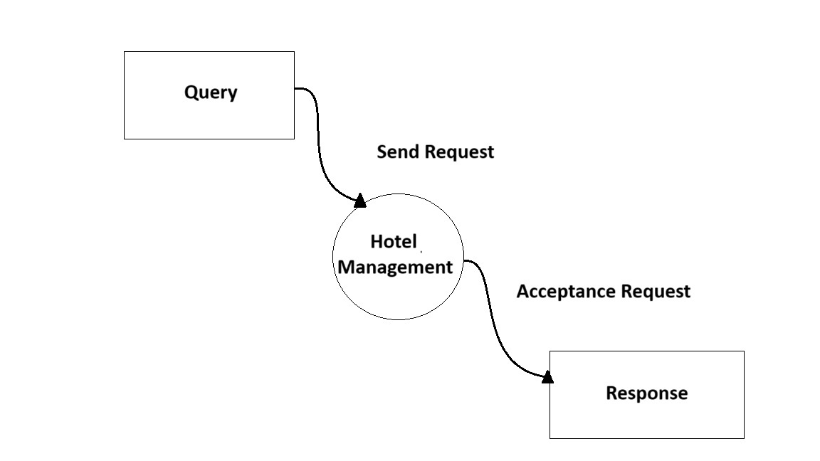
Data Flow Diagram

Slide 9
Conclusion
In conclusion, effective hotel management is crucial for the smooth operation and success of any lodging establishment. Utilizing hotel management software can streamline processes, enhance guest experiences, and ultimately contribute to the overall efficiency and profitability of the hotel.
The future scope of renowned hotels like the Taj Mahal Hotel lies in embracing innovation, sustainability, and personalized services to continue delivering exceptional hospitality experiences to guests from around the world.

